Slide 1
What’s this class about?
“Fundamentals of commonly used software tools and environments, particularly open-source tools to be used in upper division computer science courses.”

Slide 2
What is open source software?
Source code is publicly available
Anyone is allowed to modify the source code
Examples
Firefox
Android
Apache

Slide 3
GNU/Linux
Open-source operating system
Kernel: core of operating system
Allocates time and memory to programs
Handles file system and communication between software and hardware
Shell: interface between user and kernel
Interprets commands user types in
Takes necessary action to cause commands to be carried out
Programs

Slide 4
Which Linux?
Ubuntu Linux Distribution
Most popular as of 2015 for personal use
Frequently updated, fixed release cycle (6 months)
Simple installation and booting
Nice set of pre-installed packages

Slide 5
Options
1) On your computer
Install or try Ubuntu
Run with Windows (https://wiki.ubuntu.com/WubiGuide)
Easy to remove Ubuntu from Windows via Control Panel, if you don’t need Ubuntu.
2) Virtual Machine
VMWare
Virtual Box

Slide 6
3) Live CDs on BH3760 Computers
Don’t install Ubuntu
Try Ubuntu
4) SEAS Server
lnxsrv.seas.ucla.edu
Username: SEAS ID
Password: SEAS password
On windows: putty or cygwin

Slide 7
Ubuntu Linux on BH3760 Computers
Click on “Try Ubuntu” Button
Use Ubuntu trial mode every time
Need to install Linux tools we need to use
sudo apt-get install <package-name>
Example: sudo apt-get install vim
If above does not work
sudo apt-get update
sudo apt-get install <package-name>

Slide 8
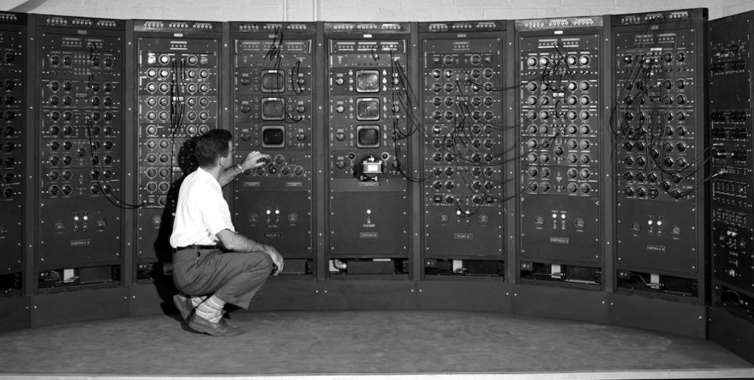
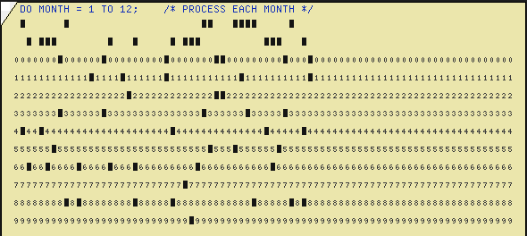

Interacting with Computers - History
Switches and Lights
Batch Processing
Teletype - CLI
GUI

Slide 9
Command Line Interface vs. Graphical User Interface
CLI
GUI
Steep learning curve
Pure control (e.g., scripting)
Cumbersome multitasking
Convenient remote access
Intuitive
Limited control
Easy multitasking
Bulky remote access

Slide 10
The Basics: Shell
<up arrow>: previous command
<tab>: auto-complete
!!: replace with previous command
![str]: refer to previous command with str
^[str]: replace with command referred to as str

Slide 11
Files and Processes
Everything is either a process or a file:
Process: an executing program identified by PID
File: collection of data
A document
Text of program written in high-level language
Executable
Directory
Devices

Slide 12
Linux File System Layout
Tree structured hierarchy
/
root
bin
dev
home
usr
tmp
lakers
celtics
bulls
lib
README
music
doc
game1
game2
Notes:
Each file is under a directory.
A directory is also a file.
Only one root “/”.
Regular files can only be leaves.
e.g., documents, music, etc.

Slide 13
Absolute Path vs. Relative Path
/
root
bin
dev
home
usr
tmp
lakers
celtics
bulls
lib
README
music
doc
game1
game2
Current directory: home

Slide 14
The Basics: Moving Around
pwd: print working directory
cd: change directory
~ home directory
. current directory
/ root directory, or directory separator
.. parent directory

Slide 15
The Basics: Dealing with Files
mv: move/rename a file
cp: copy a file
rm: remove a file
r: remove directories and their contents recursively
mkdir: make a directory
rmdir: remove an empty directory
ls: list contents of a directory
a: list all files including hidden ones
l: show long listing including permission info
d: list directories

Slide 16
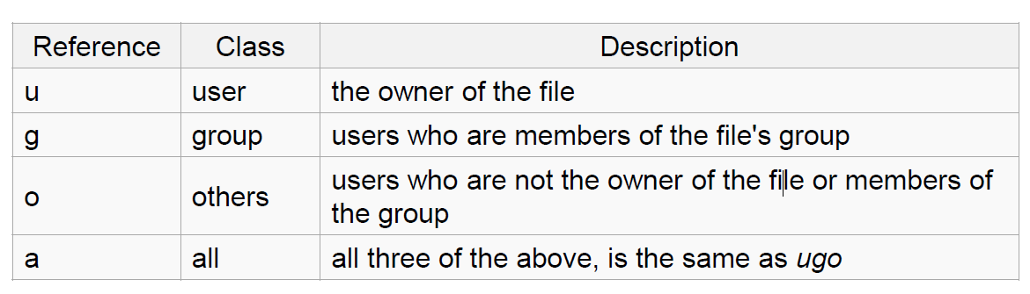
Linux File Permissions
chmod
read (r), write (w), executable (x)
User, group, others

Slide 17
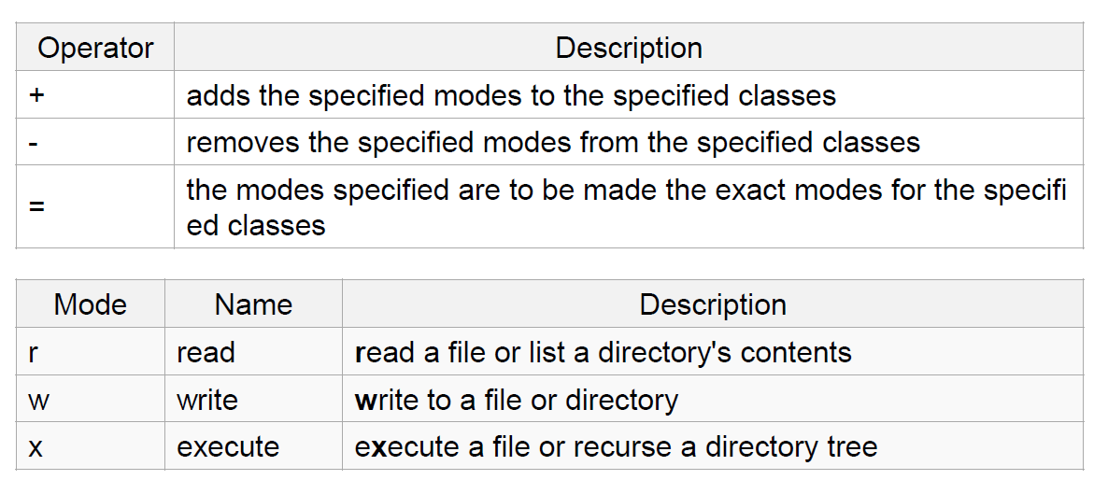
The Basics: chmod (symbolic)

Slide 18
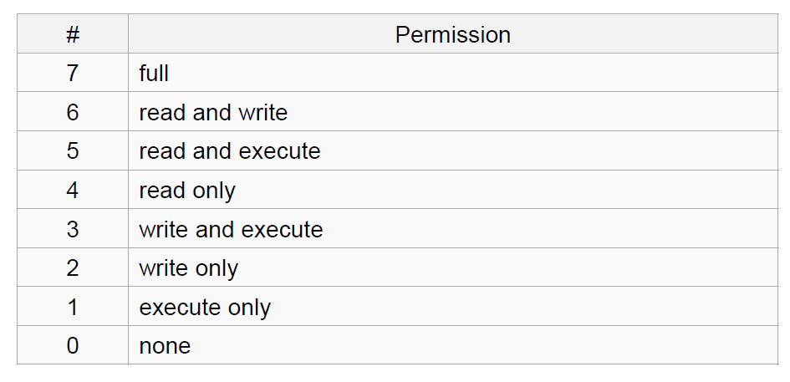
The Basics: chmod (numeric)
Usage
– chmod [''references''][''operator''][''modes''] ''file1'' ...
Example: chmod ug+rw mydir, chmod a-w myfile,
Example: chmod ug=rx mydir, chmod 664 myfile

Slide 19
The Basics: Changing File Attributes
ln: create a link
Hard links: point to physical data
Soft links aka symbolic links (-s): point to a file
touch: update access & modification time to current time
touch filename
touch -t 201101311759.30 filename
Change filename’s access & modification time to (year 2011 January day 31 time 17:59:30)

Slide 20
The Basics: find
-type: type of a file (e.g: directory, symbolic link)
-perm: permission of a file
-name: name of a file
-user: owner of a file
-maxdepth: how many levels to search

Slide 21
The Basics: whereis
locate the binary, source, and manual page files for a command
There are other useful “wh…” commands

Slide 22
man
Extensive documentation that comes preinstalled with almost all substantial Unix and Unix-like operating systems
Usage
read a manual page for a Linux command
man <command_name>
man section command_name
Hit “q” to get out of man page

